Slide 1
Quotientenregel
Galip Turan 4 ITK

Slide 2


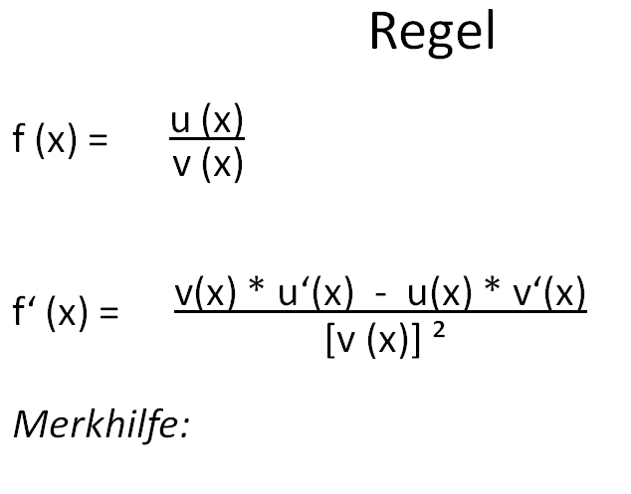
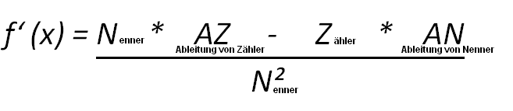

Slide 3






Beispiel
f (x) =
u = 3y² u‘= 6y
v = x³ v‘= 3x²
f ‘(x) =
f ‘(x) =
f ‘(x) =

